Slide 1

Vehicle Management System
Shreya Yadav 2210990841
Tanvi Gupta 2210990905
Taranpreet Kaur 2210990908

Slide 2
Agenda
1
2
3
4
5
Introduction
Abstract
Existing and proposed system
Code &
Code output
Conclusion&
Future scope

Slide 3
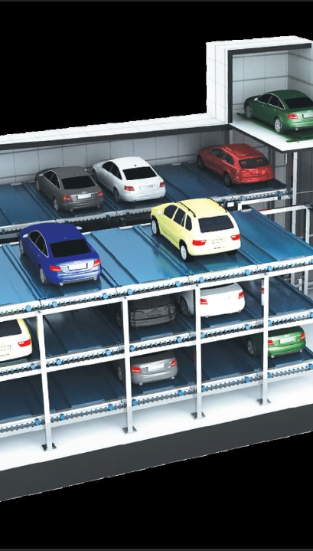
Introduction
Vehicle parking management system uses technologies and solutions to improve parking efficiency and convenience. Parking is a problem in many cities, where there is more demand than supply for parking spaces. This causes traffic, pollution, waste, and frustration. Vehicle parking management system optimizes the use of parking resources, reduces the need for new parking facilities, and enhances the user experience. It has features such as:
Smart parking systems: They monitor and guide parking availability and occupancy in real-time, and enable digital payment.
Automated parking systems: They park and retrieve vehicles automatically, saving space and time.
Parking enforcement systems: They verify and enforce parking rules and regulations, and penalize violators.

Slide 4
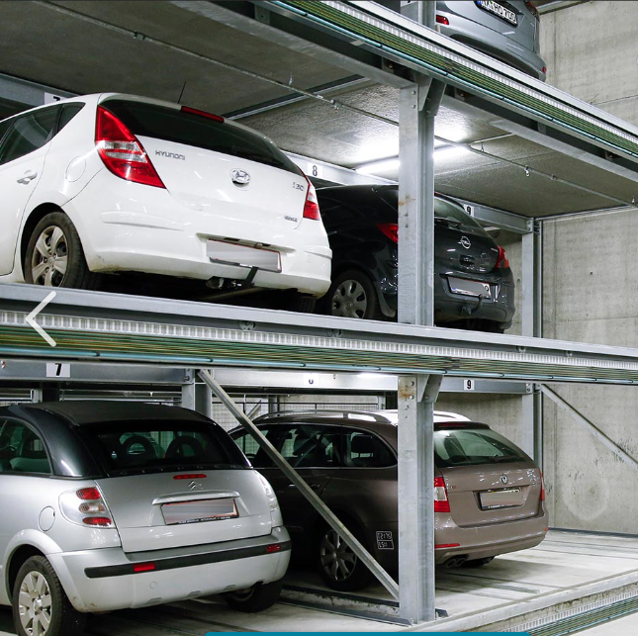
Abstract
Vehicle parking management is a solution for the urban parking problem. It uses technologies and solutions to optimize parking resources, reduce parking demand, and improve parking experience. It includes smart parking, automated parking, and parking enforcement systems, which provide real-time guidance, automatic parking, and rule verification and enforcement for parking operations.

Slide 5
Existing & proposed system
Existing system:
Paper-based system recording vehicle, distributor, purchase, sale, and account data in books. Prone to errors, loss, damage, and inefficiency. Difficult to access, update, and analyze information.
Proposed system:
Web-based Vehicle Management System (VMS) for Africonnect. Enables internal users to request, distribute, and manage vehicles for operations. Uses ERP system, UML diagrams, XHTML, JAVA, and MySQL.

Slide 6
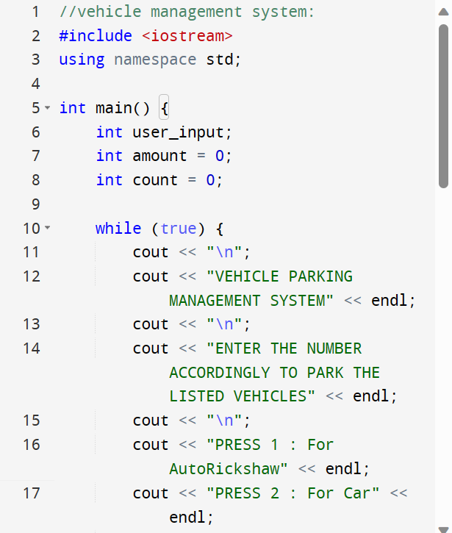
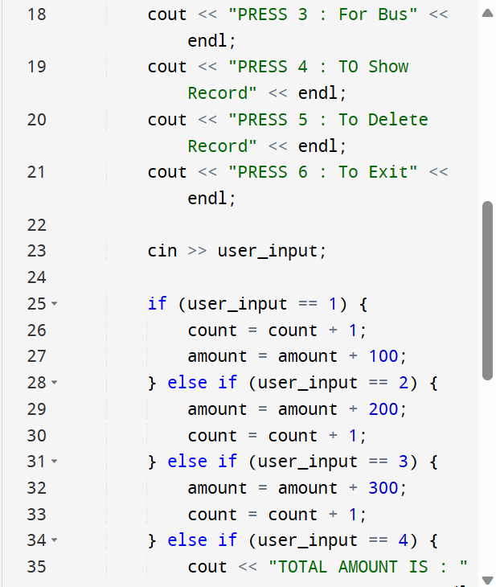
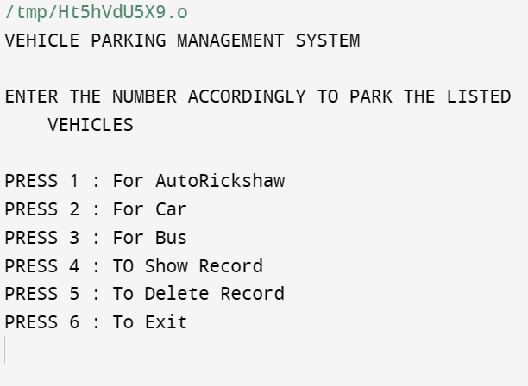
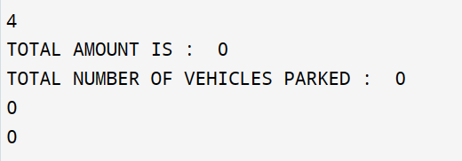
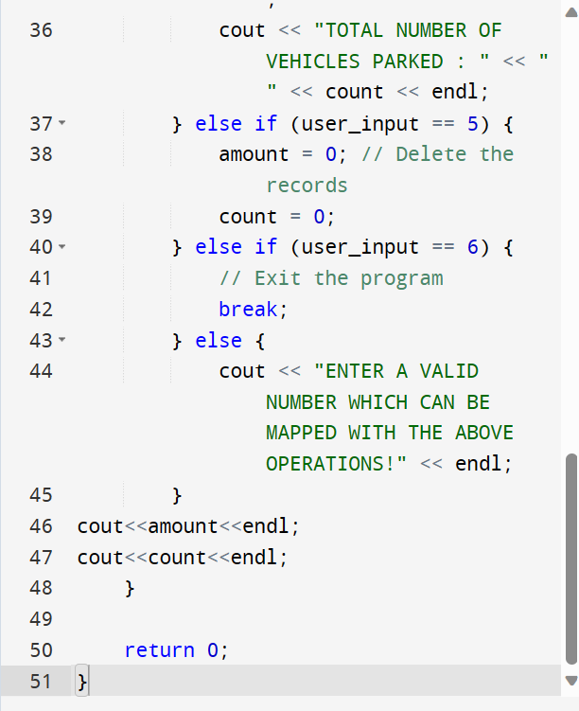


Code and its output
Output:

Slide 7



Meet our team
Taranpreet Kaur
2210990908
Shreya Yadav
2210990841
Tanvi Gupta
2210990908

Slide 8
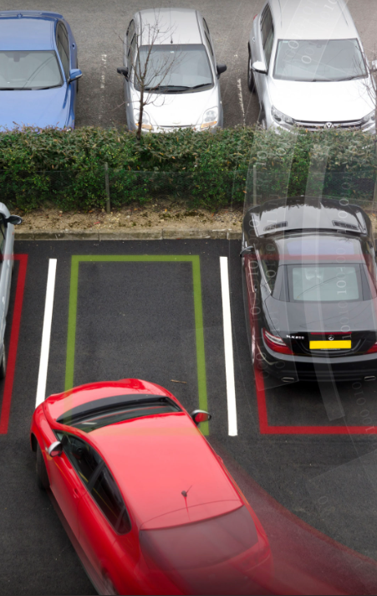
conclusion
The project of vehicle parking management aims to design and implement a smart system that can monitor and control the occupancy and availability of parking spaces in real time. The system uses sensors, cameras, and RFID tags to collect and transmit data to a central server, where a software application analyzes and displays the information on a web interface. The system also provides features such as online booking, payment, and navigation for the users. The project demonstrates the potential of using IoT and cloud computing technologies to improve the efficiency and convenience of parking management. The project also addresses the challenges and limitations of the system, such as security, privacy, scalability, and cost. The project concludes with some suggestions for future work and improvement.

Slide 9
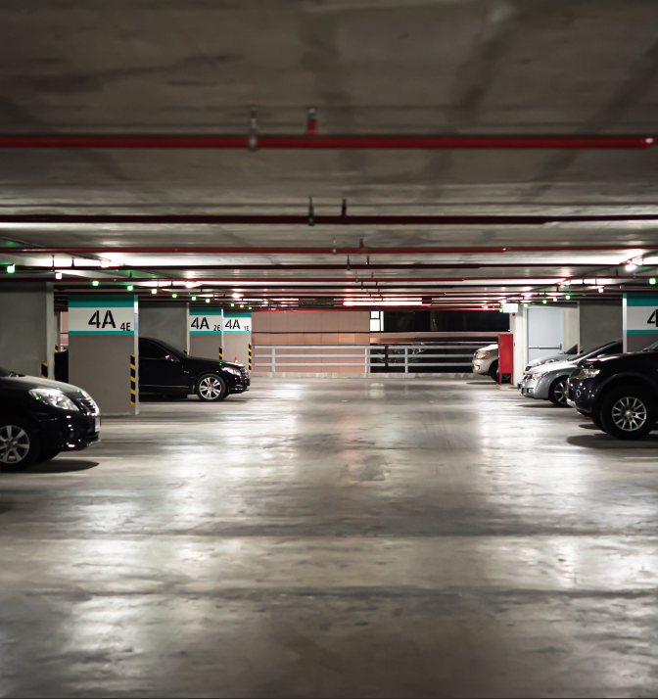
Future scope
The future scope for vehicle management system is promising as it can help to improve the efficiency, safety, and sustainability of the transportation industry.
Smart mobility
Fleet optimization
Vehicle tracking
Vehicle data analytics

Slide 10
Thank
you

